Slide 1
Analysis of a Reaction Mechanism for Use in Ejecta Particle Simulations
1
2
Ryan Myers¹, Frederick Ouellet², Nicholas Denissen², Jonathan Regele² and Jacob McFarland¹
LA-UR-23-26764

Slide 2
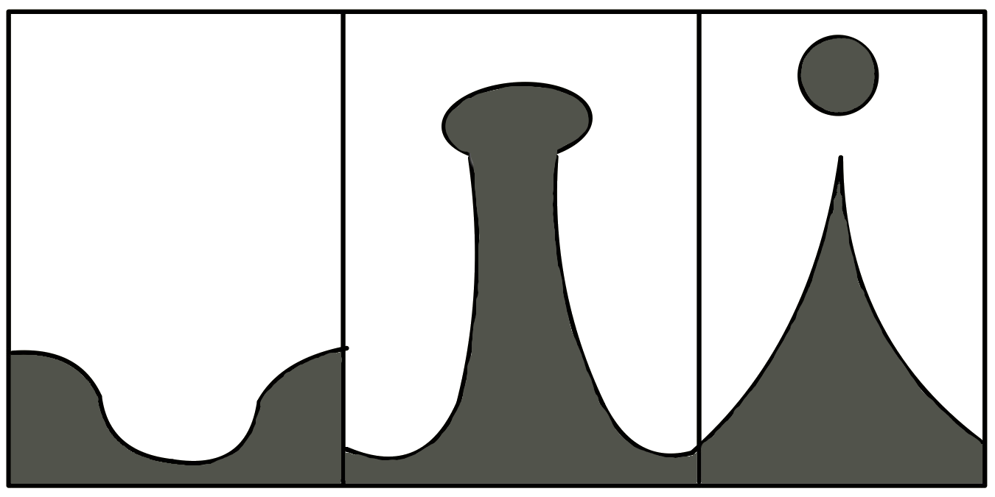
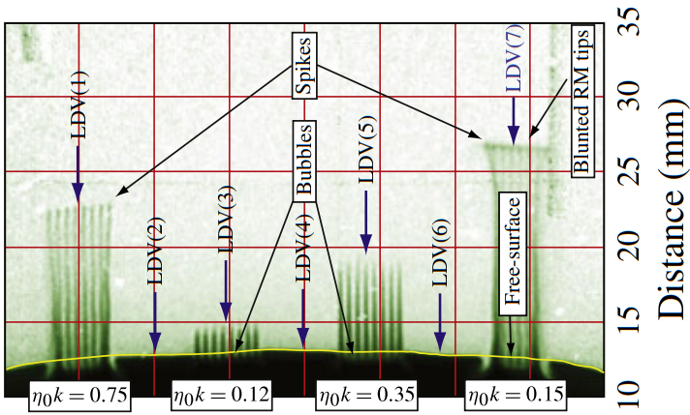
Ejecta Introduction
Ejecta is a fundamental problem for understanding the physics of fusion.
When metals are subjected to strong shocks, impurities on the surface (from machine finishes, scratches, and cracks) can enable ejecta particles formation.
The incident shock is transmitted through the metal, liquifying it at very high Mach numbers.
Surface oscillates until the spikes grow long enough to deposit ejecta into the open space.
Result of a Richtmyer-Meshkov Instabilty induced on a solid or liquid interface.
Limiting case for $At= \frac{ρ_{g}−ρ_{m}}{ρ_{g}+ρ_{m}}≈−1.$ Where $ρ_{m}$ is the post shock metal density and $ρ_{g }$is the gas medium
From Buttler et al. (2021): Particle diameters are ~(O) 1 micron (vacuum) to ~(O) 10 micron (He), the relative flow field velocity is ~500 m/s.
Pre-shock surface
Transmitted Shock
Material Surface
Spike Formation
Qualitative visual of RMI driven gas hydrodynamics. Credit: Ben Musick
Ejecta Launched
Shocked metal surface forming RMI spikes, Buttler et al. (2012)

Slide 3
Reactive Ejecta
Experiments from Buttler et al. (2021) gave insight into possible modes of break up and deformation for reactive ejecta:
Found: simultaneous hydrodynamic and reaction breakup processes, rapid heating as a result of an exothermic reaction, particles reached a constant temperature (~1500 K), varying acceleration in particles.
Questions: product shell behavior, hydrodynamic stability, reactive breakup processes, phase change, product/metal spallation

Slide 4
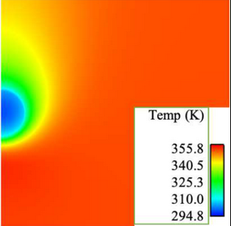
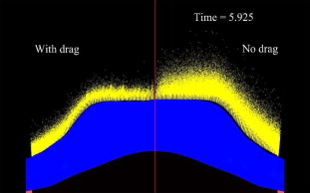
Problem Description
Simulate a resolved reactive ejecta particle and analyze the different influences on overall breakup to better inform point particle simulation models of ejecta.
Gas Flow
Resolved particle simulation analyzing heat transfer over an ejecta particle. Maxon et al. (2021)
Simulated ejecta (point particles) being generated into gas and a vacuum. Fung et al. (2013)

Slide 5
Current Physical Processes Considered
Micro:
Meso:
Product lattice unit cell
Interstitial Travel
Diffuses to next molecule in lattice
Adsorbed gas molecules
Cracking
Excitation
Excitation
Melting Layer
Reaction Front
Macro:
Gas Velocity
Deformation
Product spallation
Gas Diffusion
Ce
Ce
Ce
Ce
Time
CeH₂
Ejecta formation
Reaction product cap formation
Cap growth and spalling
Heat transfer

Slide 6
Reaction Front
A reaction front is a region between two materials that separates them as a reaction progresses.
Often reaction fronts are not uniform and have a finite width, which changes based on reaction speed and scale, and can be described with a velocity.
Cerium
Cerium Hydride
$$H_{2} diffusion$$
$$Ce+H_{2}→CeH_{2}$$
$$\left(Flux of mass and energy\right)$$
Reaction Front
When describing our problem, $Ce+H_{2}→CeH_{2}$, we assume that the reaction front can be described as the surface between two materials.
This allows us to model the reaction front as a mass and energy flux between two discretized volumes in our domain.
Reaction front of gypsum and bassanite showing the difference between a narrow (left) and wide (right) reaction. Material, geometry, reactivity, temperature, and many other factors affect the reaction process. Leclère et al. (2018)

Slide 7
Implemented Reaction Mechanism
Lagrangian Hydrocode Continuum Governing Equations, from Fung et al. 2013:
$$ρ\frac{d(ρ^{−1})}{dt}−∇∙\left(v\right)=0$$
$$ρ\frac{dv}{dt}+∇P=0$$
$$ρ\frac{de}{dt}+P∇∙\left(v\right)=0$$
When the reaction mechanism is activated, it identifies the affected mesh cells and then adds mass and energy to the zone tagged as the product, acting as a source. For the zone tagged as the reactant it follows the same procedure, but subtracts mass and energy, acting as a sink.
The mechanism is implemented as,
$$m^{t}=m^{t−1}±\dot{m}′′A_{s}∆t$$
$$e^{t}=e^{t−1}±\dot{e}′′A_{s}∆t.$$
Where the fluxes, $\dot{m}′′$ and $\dot{e}′′$, are a function of the chemical reaction$.$The reaction is implemented at the beginning of the time step to allow the hydrocode to properly handle the cells geometric change in accordance with the implemented equation of state.
1. Tag nodes on user defined reaction front
2. Create reaction front surface on mesh
3. Identify materials as reactant and product for reaction

Slide 8
ALE
Arbitrary Lagrangian-Eulerian (ALE) mesh remapping:
Used for fixing meshes or for fluid-structure interactions, generally.
Remap the particle to allow the reaction to change properties, but not interfere with hydrodynamic breakup.
Allows the particle to reflect changes in mass and energy but preserves the mesh quality by redistributing that mass throughout the material zone.
1 gram
1 gram
1 gram
Reaction Front
Add mass then step forward in time
1.3 grams
1 gram
1 gram
Before next timestep, remap with outer boundary as fixed BC’s
1.15 grams
1.15 grams
1 gram

Slide 9
2D Core Depletion
In order to show the stability of this method we applied a 1:1 reaction between the same materials to see how it affects the mesh of our domain. While not physically representative of any reaction, it is an easy thought experiment to verify our methods.
R=0
R=1
R=2
Stability was seen throughout the simulation, and cell volumes did not deform to a non-structured state.

Slide 10
1D with Different Densities
One physical difficulty to our problem is that the solid product of the reaction is less dense than the metal reactant.
Is there a stable shell thickness? How does the shell develop? Does flaking or cracking occur before the particle starts to hydrodynamically breakup?
In order to see the effects on shell layer thickness in a 1D spherical domain, we assign two materials similar in density to our physical problem (cerium is 6.76 gcc and cerium hydride is 5.45 gcc).
The shell is prescribed a mass reaction rate that will enable it to grow 10% over 15 us. This is similar to the hypothesized growth rate based off previous analysis of reacting cerium particles.
Note: The reaction is not limited by availability of hydrogen. We theorize that this is a significant limiting factor to the reaction time seen in experiments.

Slide 11
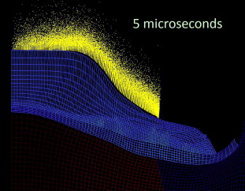
Future Work
Future Mechanism Additions:
Incorporate a mixed material zone within the domain, then allow the reaction mechanism to work as a function of availability.
Add mass diffusion solvers (which work as a function of temperature) to simulate gas availability for the reaction.
Connect to coupled solid mechanics to simulate spallation and cracking.
Future Simulations:
Simulate the particle in still gas to watch the effects of the reaction breakup processes.
Observe phase change of the $CeH_{2}$ shell.
Start with a near zero-thickness shell to find a stable shell radius.
Add 2D effects by adding the particle to a flow field, similar to the post shock environment in experiments.
Change a priori hydride shell geometry from uniform to heterogeneous, as expected from experiments.
Resolving these questions will help to inform point particle ejecta simulations in the future. Fung et al. (2013)

Slide 12
Acknowledgements
Thank you for your time!
Contact: ryanmyers@tamu.edu
Thank you to ASC PEM Mix and Burn, and the XCP-4 and HPC groups at Los Alamos National Lab for the use of their resources.
Also, thank you to the FLAG project group for their support and documentation.
Lastly, thank you to my fellow lab mates for the support and guidance.

