Slide 1
Analysis of a Rayleigh-Taylor Instability
Created by Radiation-Driven Dust
Hanif Zargarnezhad
Advisor: Dr. Jacob McFarland
Mechanical Engineering Department
Texas A&M University
Nov. 2023

Slide 2
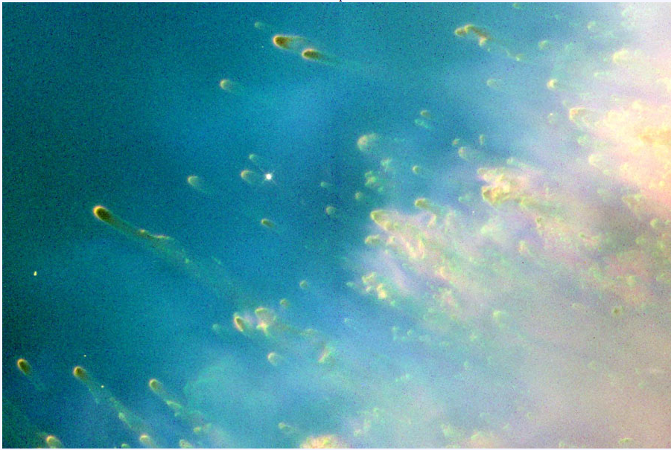
Application
Radiation-particle interactions, momentum transfer
Two-way coupling of momentum and energy between the dust and gas drive hydrodynamic instabilities
Particles can clump together due to radiation
Complex dynamics in the dilute regime
F_{drag}
Rarefied gas
Investigating dust-radiation interaction in planetary nebulae (PNe)
Modeling clump formation due to radiation field variations and thermal convection
Improve understanding of radiation's role in shaping dust and gas structures.
Particle
Radiation
F_{radiation} - F_{gravity}
Gravity
Cometary knots in the Helix Nebula.
Image Credit & Copyright: Ignacio Diaz Bobillo
1

Slide 3
Motivation
Does the finger-shaped pattern in Rayleigh-Taylor instabilities (RTI) create cometary knots in PNe?
Assume the driving physics are radiation and gravity
Outcome of First Publication:
P. Woitke (2006), doi: 10.1051/0004-6361:20054202c ESO 2006
Drag heating is essential for precise gas temperature determination
Initial stellar radiation induces strong dust perturbation, diminishing over time and distance
For more see Zargarnezhad et al. 2023 “Radiation driven-dust hydrodynamics in late-phase AGB stars”
Plot of particle (color) and gas (black and white) velocities [km/s]. Time is in year.
Butterfly Nebula. HUBBLE/NASA
2

Slide 4
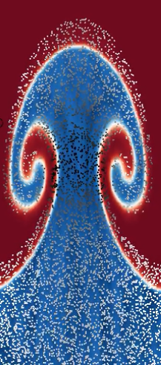
Fundamental of RRTI
Introduction
Significance of Multiphase Radiation-Driven Rayleigh-Taylor Instability (RRTI)?
High opacity particles tend to push the surrounding gas while the light opacity gas tends to sink.
Gap in knowledge: Lack of consideration for multiphase effects.
Study a single-gas RRTI with particles and compare with a conventional RTI
Investigate growth lengths and temporal evolution of instabilities
g
$$k_{2}$$
$$ρ_{2}$$
$$ρ_{1}$$
$$k_{1}$$
$$P_{0}$$
Radiation
Conventional RRTI with different opacities

Slide 5
Linear RRTI Analysis
The Growth Rate Solution
$$RRTI: S^{2}= \tilde{k} \frac{Ι}{2c}\left[κ_{g,2}+κ_{g,1}\right]A_{r}$$
$$A_{r}=\left[\frac{κ_{g,2}−κ_{g,1}}{κ_{g,2}+κ_{g,1}}\right]$$
$${RTI: S}^{2}=\tilde{k}gA;A=\left[\frac{ρ_{2}−ρ_{1}}{ρ_{2}+ρ_{1}}\right]$$
To obtain the same growth rate
$$g=\frac{Ι}{2c}\left[κ_{g,2}+κ_{g,1}\right]$$
$$k_{1}$$
$$ρ_{2}$$
In linear RTI
$η= η_{0}e^{\frac{t}{τ_{RTI}}}$; $τ_{RTI}=\sqrt{\frac{λ}{2πgA}}$
If ${ η}_{0}.\tilde{k}≪1 ∴$ ${ η}_{0}=0.01$ $\frac{λ}{2π}$
$$k_{2}$$
g
$$ρ_{1}$$
I
RTI
RRTI

Slide 6
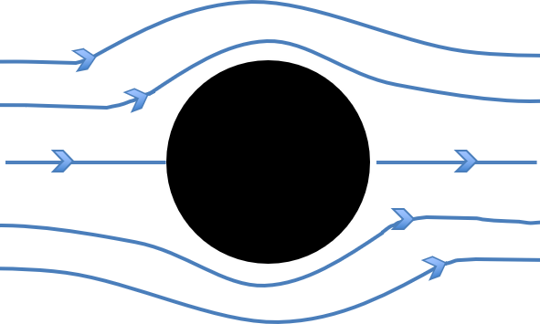
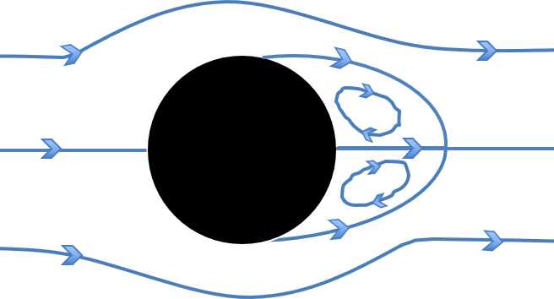
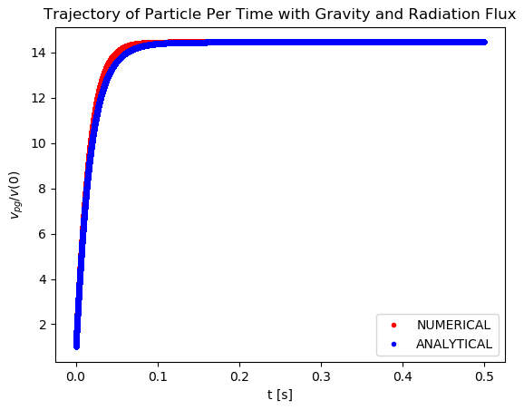
Lag Between Particle and Gas
Defining the Stokes number:
$$St= \frac{τ_{p}}{τ_{RRTI}}$$
RRTI time scale:
$$τ_{RRTI}=\sqrt{\frac{λ}{π\frac{Ι}{c}\left[κ_{g,2}+κ_{g,1}\right]A_{r}}}$$
Particle time scale (terminal velocity time scale):
$$τ_{p}=\frac{1}{k}\ln{(\frac{A−kRe (0)}{A−k Re})}$$
$$A=\left|\frac{3}{4}\frac{Q_{abs}}{r_{p}ρ_{p}}\frac{I}{c}−g\right|∗\frac{4}{3}\frac{ρ_{p}ρ_{g}}{μ^{2}}D^{3}$$
Stokes regime
Non-linear Stokes regime

Slide 7
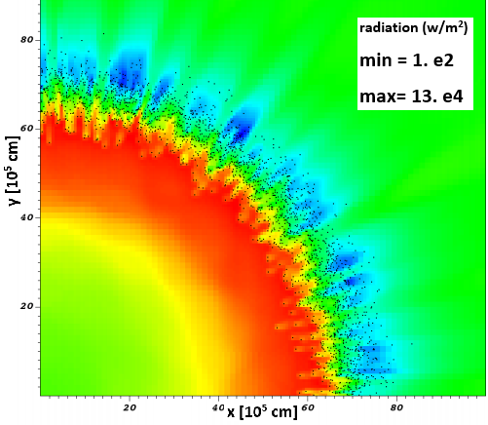
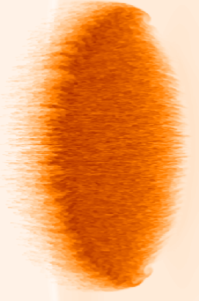
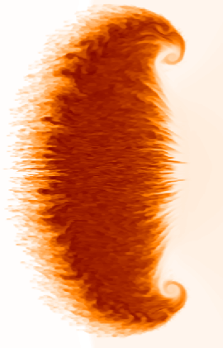
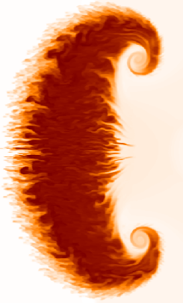
Numerical Method
FLASH Code
Developed for compressible flow problems found in astrophysics
Particle-In-Cell Capabilities Developed in FLASH
Three-dimensional implementation with two-way mass, momentum, and energy transfer
Added radiation force and energy on particles and gas, and implemented a drag model on the particles
Third-order accuracy in space integration and second-order time integration
Example of radiation shadows effect on particles in a box
Example of hydrodynamic instability evolution.
(Dahal & McFarland 2017)
6

Slide 8
Initial Condition
Hydrogen gas
$μ_{g}$ = 8.76e-5 pa.s., $ρ_{L}=0.0899;{ ρ}_{H}=0.11\frac{kg}{m^{3}}$
Atwood = 0.1; $τ_{RTI}=0.032;P_{0}=101.325 kpa$
Reflect
Graphite solid particles, uniform distribution
$$m_{p}=\left(\frac{2A}{1−A}\right)V_{g} or \frac{m_{p}}{m_{g}}=0.22 per zone$$
Reflect
Reflect
 | (cm) | NB
x | 6.28 | 36
y | 31.4 | 160
Lagrangian points |  | 328k
particle diameter (um) | Total number of particles | Parcel
0.1 | 2.26e15 | 6.9e9
1 | 2.26e12 | 6.9e6
5 | 1.81e10 | 5.52e4
Left: gas simulation
Right: multiphase simulation
Boundary conditions: reflected/wall for all faces
Reflect

Slide 9
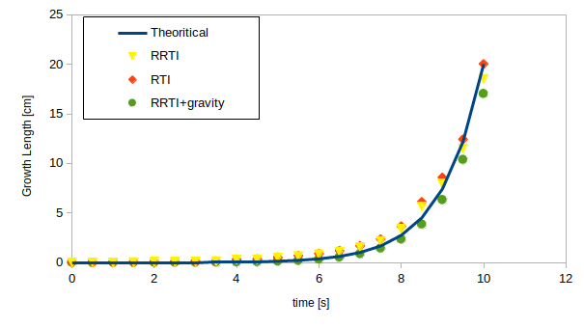
Results- Single Gas
Good agreement between RTI (left, gravity-driven) and RRTI (right, radiation- driven) results
The growth length of RRTI is smaller than other cases
$$g=\frac{Ι}{2c}\left[κ_{g,2}+κ_{g,1}\right]$$
RTI
RRTI

Slide 10
Results- Multiphase flow
Multiphase flow has a similar behavior as single gas simulation has.
The multiphase flow shows a good coupling between dust and gas.
Single gas
Multiphase flow

Slide 11
Conclusions & Future Works
We are exploring different particle sizes, finding a possible transition Stokes number
Gas phase simulation of RRTI has a good agreement with RTI.
Exploration of Multiphase RRTI: with uniform size and distribution, the hydrodynamic growth is similar to single gas simulation.
Future Work:
Study non-uniform size and spatial distributions: size disparities and particle clustering
Explore radiation heating of the gas and resulting gas buoyancy force, simultaneous RT and RRTI.
$$D_{p}=0.1 um \text{in} \text{t}\text{= 6. }\text{s}$$
$D_{p}=0.5 um$in t=7 s
Comparison of multiphase RRTI for different particle sizes (Stokes numbers)

Slide 12
Thank you for your attention
Question?
Acknowledgements
National Science Foundation (NSF)
Research Computing Support Services at the University of Missouri, Columbia
High performance research computing group at Texas A&M University, College Station
First Publication, URL: https://doi.org/10.1016/j.ascom.2023.100766

